Slide 1
Portfolio Review
JoAnne Geigner

Slide 2
Communication & Marketing Plans
Communication plan for Bruce D. Nesbitt African American Cultural Center opening.
Messaging calendar
Marketing plan for Siebel Center for Design opening and beyond.
Marketing plan for University Housing (ISU) and college housing in general.
Notes:
In your packet, I’ve included the communication plan for the Nesbitt African American Cultural Center opening and the marketing plan for the Siebel Center for Design building opening.

Slide 3
Tree in Fog
This was a photo I took of the Blair Park tennis courts across the street from my house.

Slide 4
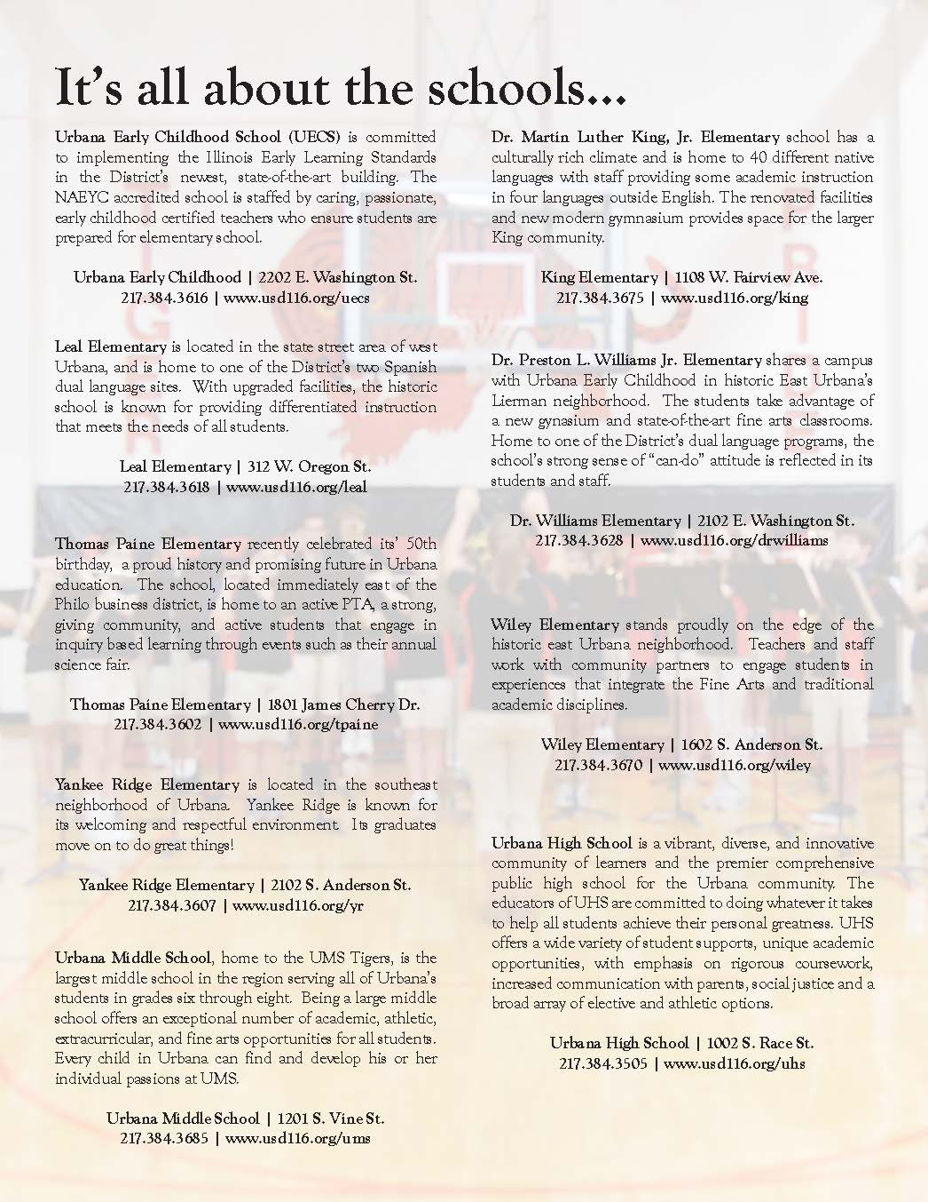
One-Sheet & other Flyers
One-sheet informational for Urbana School District #116

Slide 5
Path in the Trees
In the Lac du Flambeau area of the North Woods of Wisconsin – there are a number of areas were the trees were planted in a row like this – creating pathways.

Slide 6
Advertisements
Notes:
I did several advertisements for MTD – several that went into their Maps and Schedule book and several that were used as flyer on the inside of the buses.

Slide 7
#NASASocial
I attended the NASA Social event for the SpaceXDragon CRS6 #ISSCargo mission, at Kennedy Space Center, Cape Canaveral, Florida - April 12 – 14, 2015.

Slide 8
Press Releases

Slide 9
Funnel

Slide 10
Feature Stories
UMS Handbells – featuring UMS band director and music teacher, Karen Debauche.
Dr. King kindergarten teacher, Bryan Lake, honored as Presidential Award winner.

Slide 11
Molten Steel
Close up of a bridge of the Chicago river taken from a very slow moving Amtrak.

Slide 12
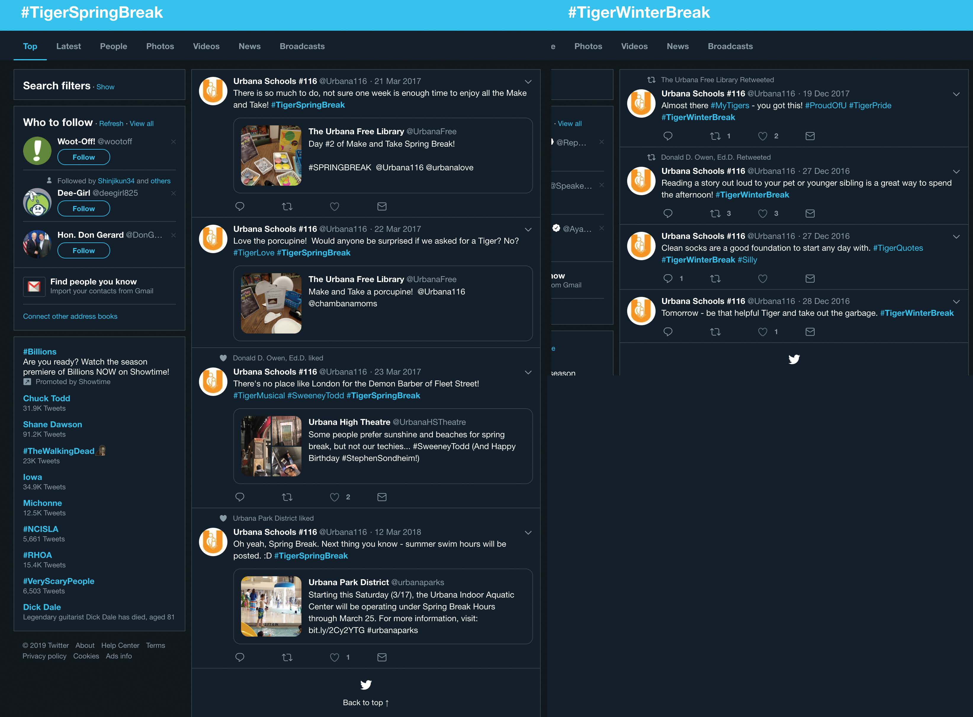
Social Media
Hash tag stories
#TigerWinterBreak (and #TigerSpringBreak, etc.)
#ProudOfU
#TigerPride
Notes:
Hash tag stories
#TigerWinterBreak (and #TigerSpringBreak, etc.)
#ProudOfU
#TigerPride
Facebook posts
Informational posts about events
Shout-outs and congratulations
News and media outlet stories
Reposting good news

Slide 13
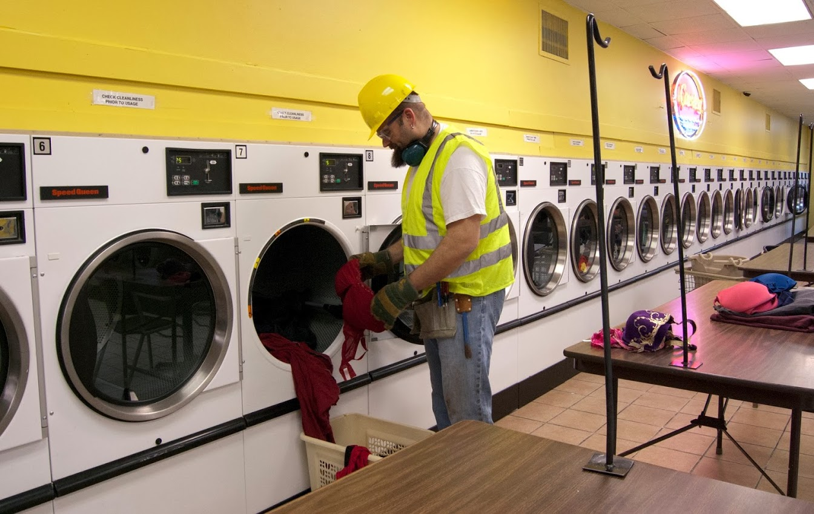
Gender Deconstruction
2013 Uncommon Interests Photography Exhibit
November 2013
Presented the series “Gender Deconstruction” during the 2013 Uncommon Interests photography exhibit at Indi Go Artists co-op. This was a series of 3 photographs with a head nod towards the absurd, presenting my take on masculine and feminine stereotypes.

